Slide 1

A PROJECT REPORT
ON
ONLINE ATTENDANCE TRACKER
Submitted By
NAME ID
MD. Rakibul Islam 11708020
Helal Hossen 11708007
Ashikur Rahman Showrov 11708008
Ahsan Habib 11708011
Syed Ashraf Asif 11708009
COMILLA UNIVERSITY :: CUMILLA – 3506

Slide 2
Contents
1. Introduction
2. Literature review
3. Overall Description Of Project
4. Methodology and Design
5. Implementation and Results
6. Conclusion

Slide 3
Introduction
"Online attendance tracker" is an online-based system where attendance will be tracked by an online system. There will be an option for both student and teacher so that every student and teacher can get their respective subject attendance information.
This project aims at managing attendance details of students so that both students and teachers have all the attendance –related information of respective subjects and respective streams.

Slide 4
Literature Review
Existing system is a manual entry for the students. Here the attendance will be carried out in the hand written registers. It will be a tedious job to maintain the record for the user. The human effort is more here. The retrieval of the information is not as easy as the records are maintained in the hand written registers.
This application requires correct feed on input into the respective field. Suppose the wrong inputs are entered, the application resist to work. so the user find it difficult to use.
There are some others project on this work. But there are some issued on those work. In them anyone can login or signup. But it is a major problem.
To overcome the drawbacks of the existing system, the proposed system has been evolved.

Slide 5
Overall Description Of Project
Our system has two types of accessing modes:-
i. Teacher
ii. Student
(i) Teacher: Teacher have rights to manage student details, add a new student, provide register number for all students, assign each student a course etc., Teacher can update his profile, and also can give help to the students.
(ii) Student: Student can see profile, Attendance Details etc. student.

Slide 6
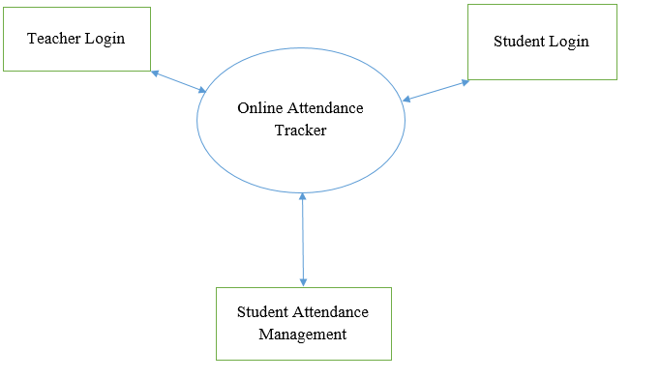
Methodology And Design
Figure: Zero Level DFD

Slide 7
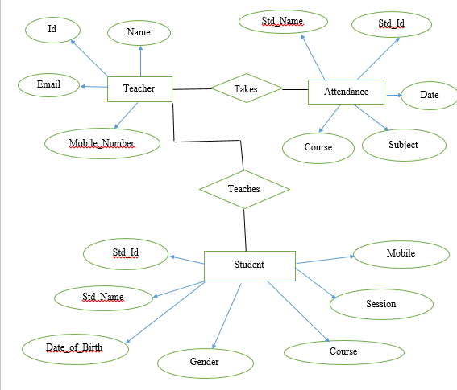
Figure: E-R Diagram

Slide 8
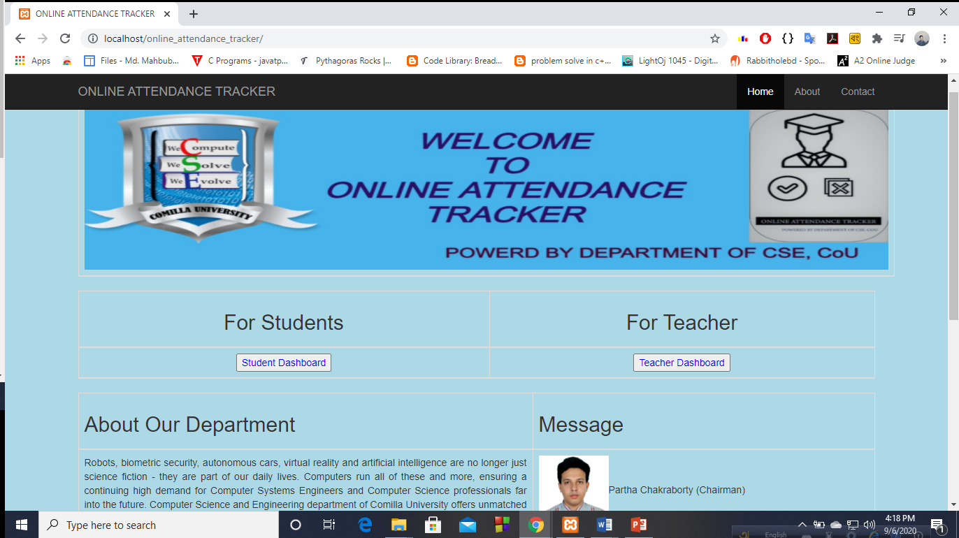
Figure: Homepage
Implementation and Results

Slide 9
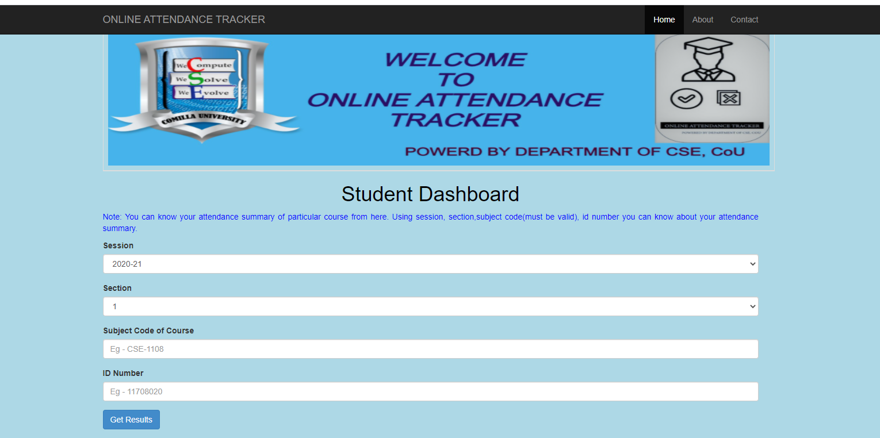
Figure: Student Dashboard

Slide 10
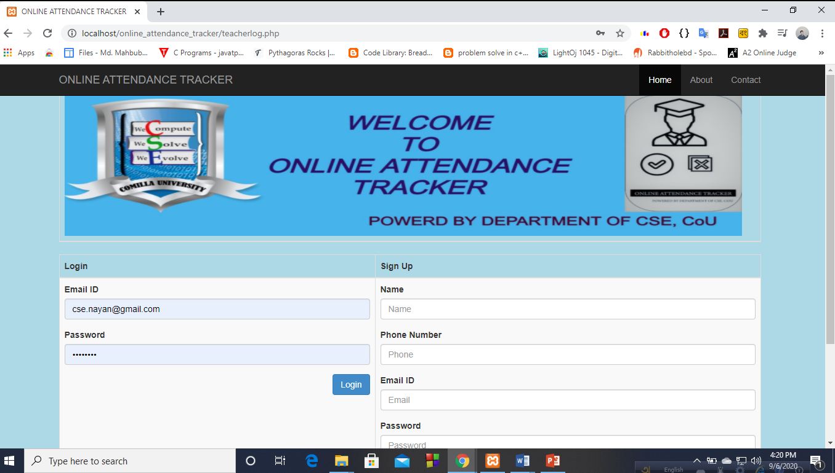
Figure: Teacher Dashboard

Slide 11
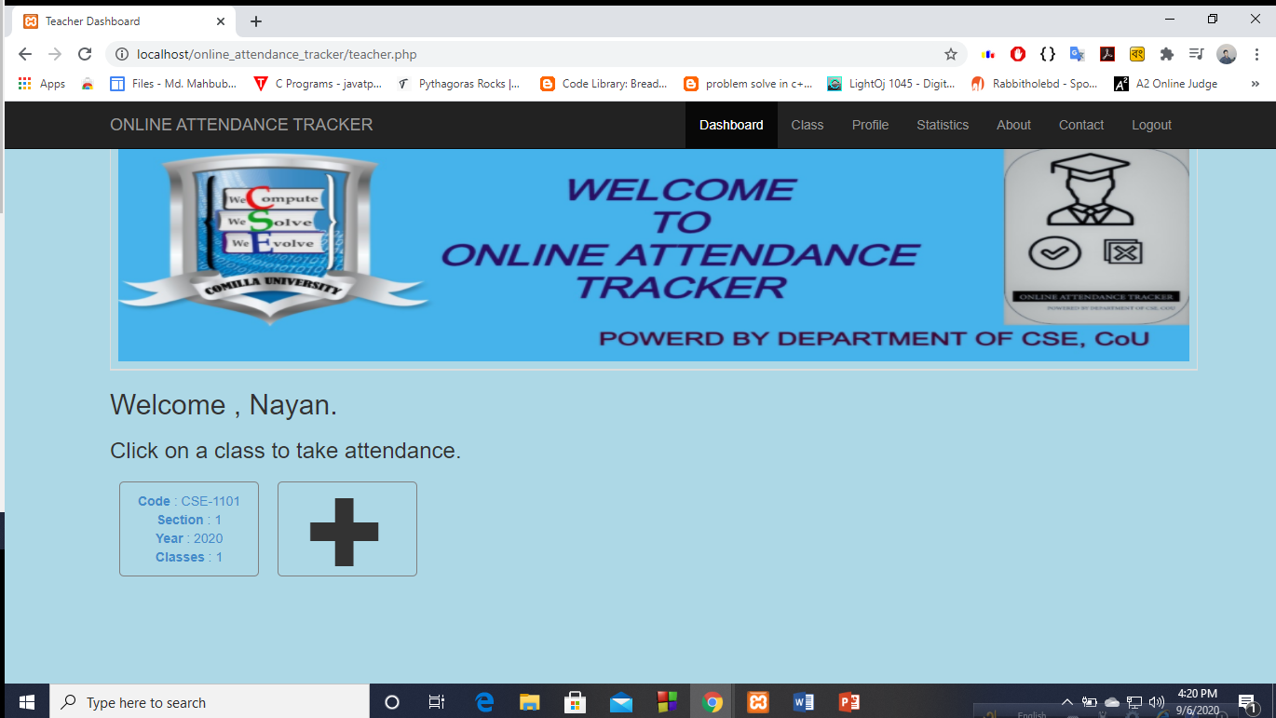
Figure: Teacher Homepage

Slide 12
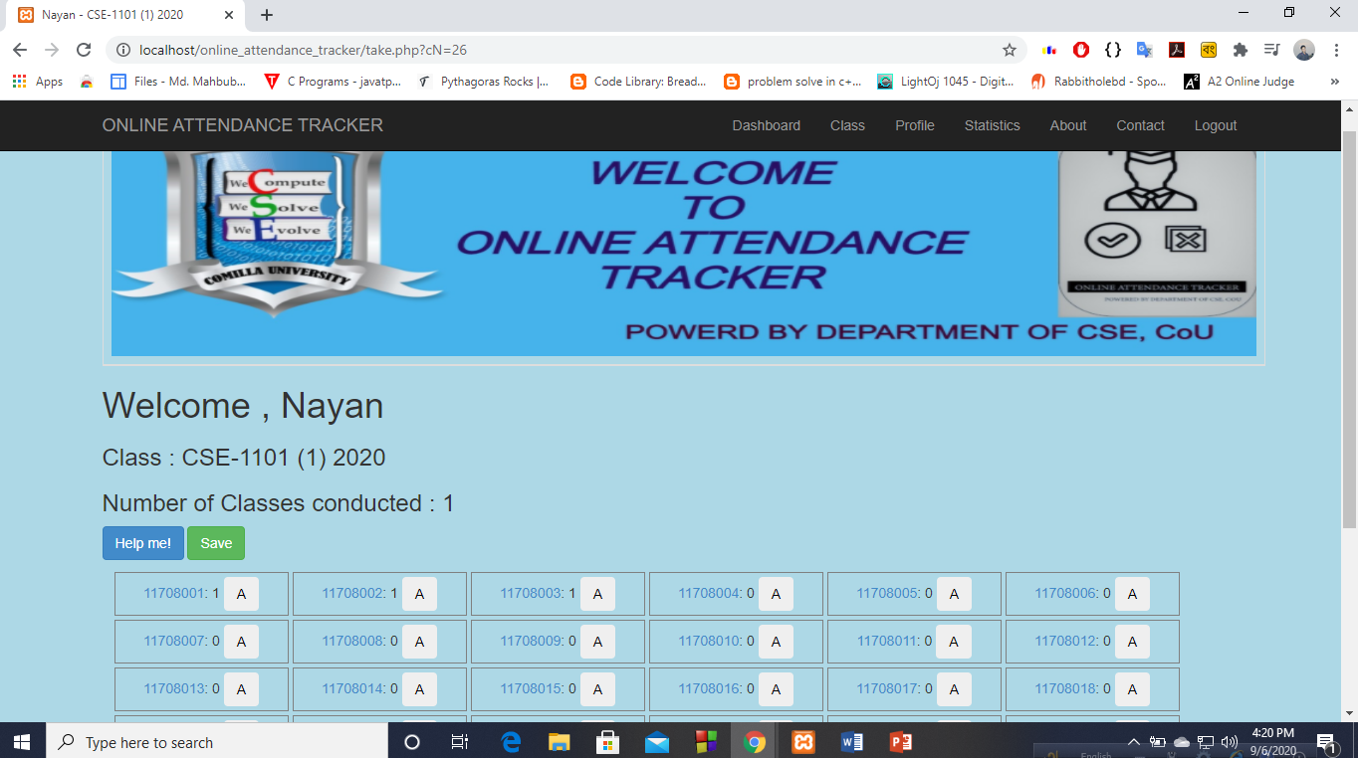
Figure: Attendance Page

Slide 13
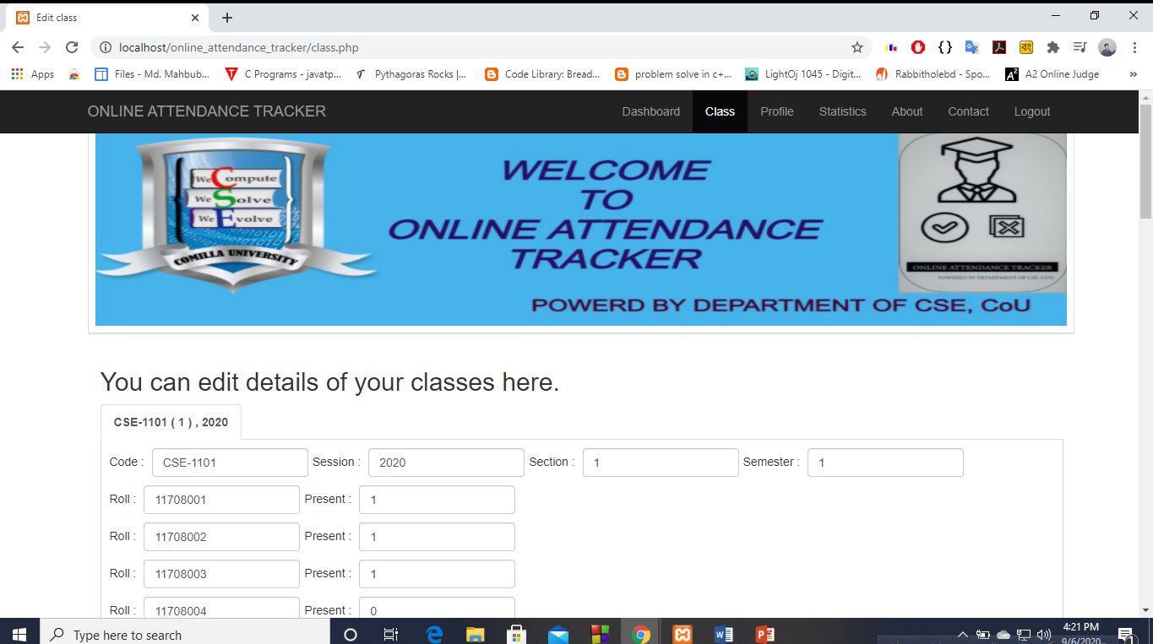
Figure: Class Updating Page

Slide 14
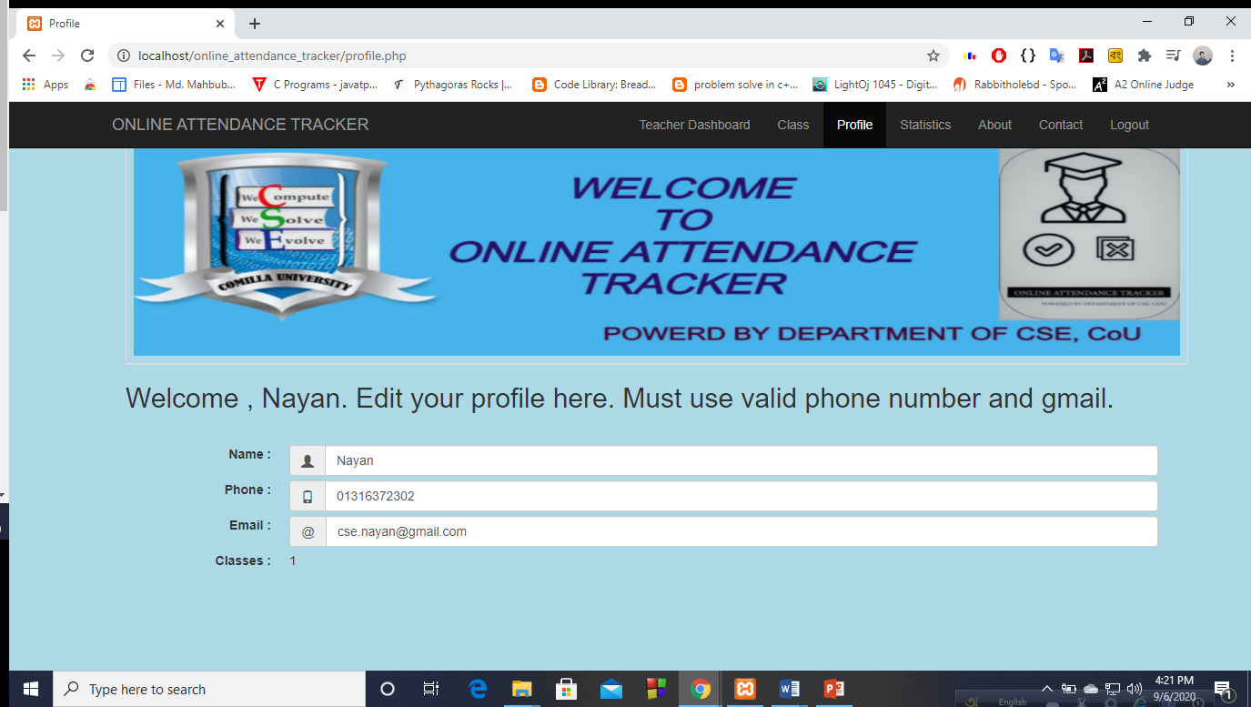
Figure: Teacher Information Updating Page

Slide 15
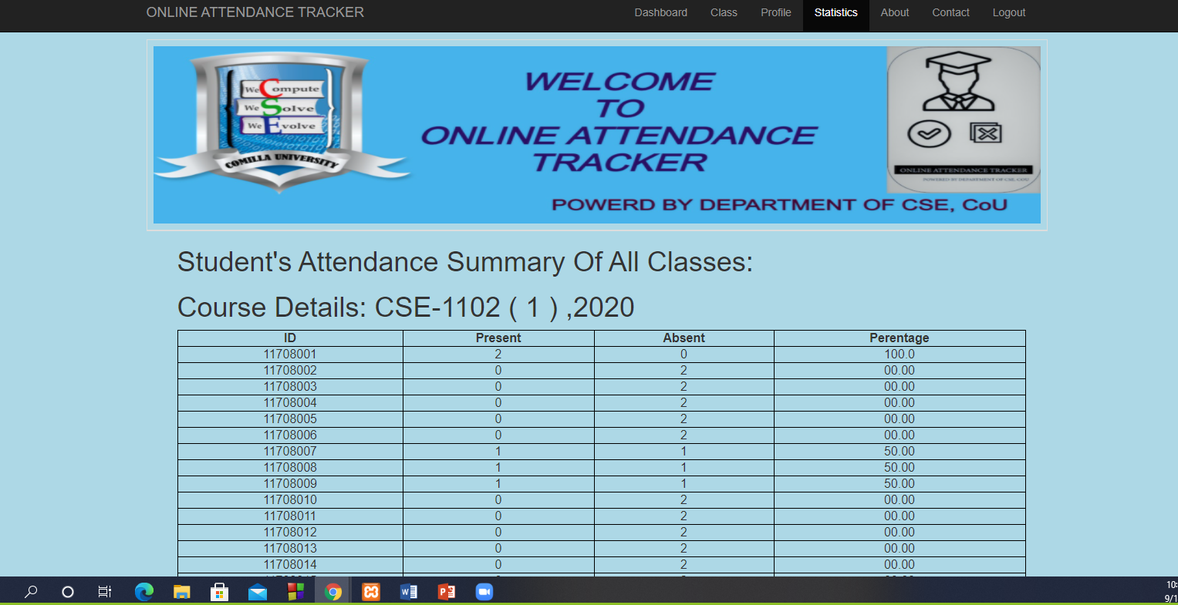
Figure: Student Statistics Page

Slide 16
Conclusion
"Online attendance tracker" can help both teachers and students. Teachers can easily maintain a student’s attendance. A student can also get about his/her attendance details by following this project.
There are some features that need to be included in this project in the future to make the website more efficient and fully functioning.
1. We will try to add students the result of every semester here so that they can get there result easily.
2. We will try to add a fingerprint here.
3. We will try to add such an option so that if any student does less than 60% attendance then the teacher can notify him/her and their guardian.

